Slide 1

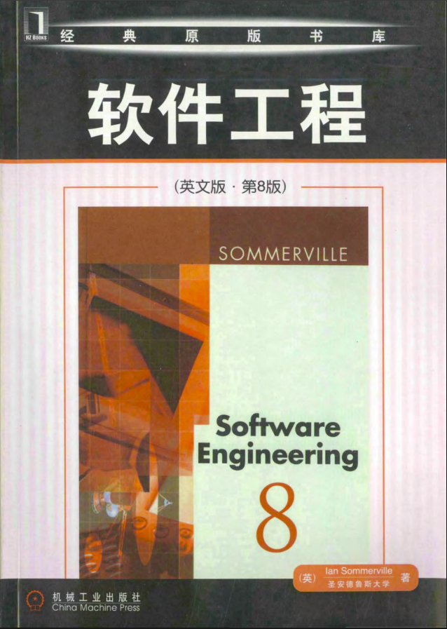
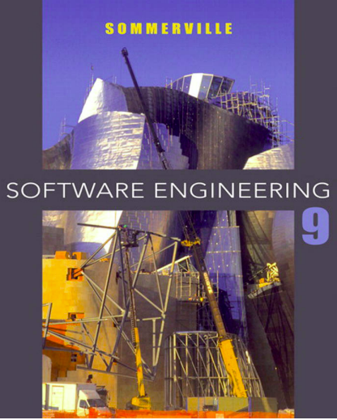
Prescribed textbooks

Slide 2
Importance of SE
Software bug that almost caused 3rd world war(1983)
Invention of SS accidentally (1979, visicalc)
One small package caused big trouble to mnc’s(left_pad)
NASA bug that caused $125M loss.(1999, NASA eng-newtons, SubContractor-pound force)
Y2k problem

Slide 3

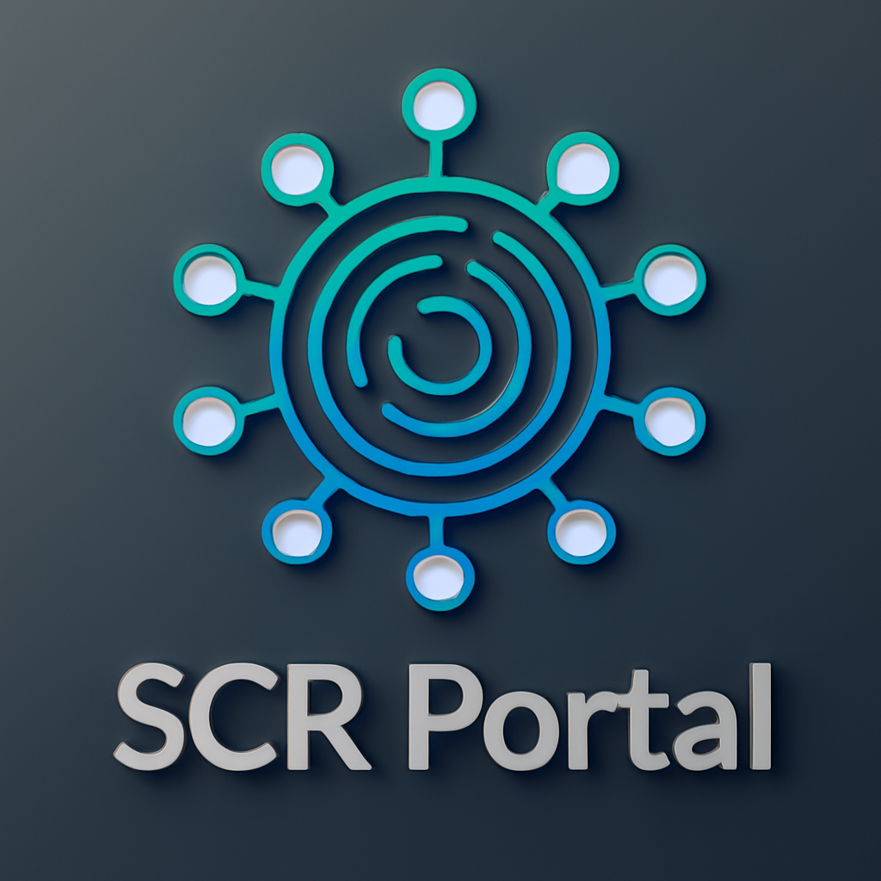













Software Engineering
-Goutham

Slide 4
Software Engineering
-Goutham

Slide 5
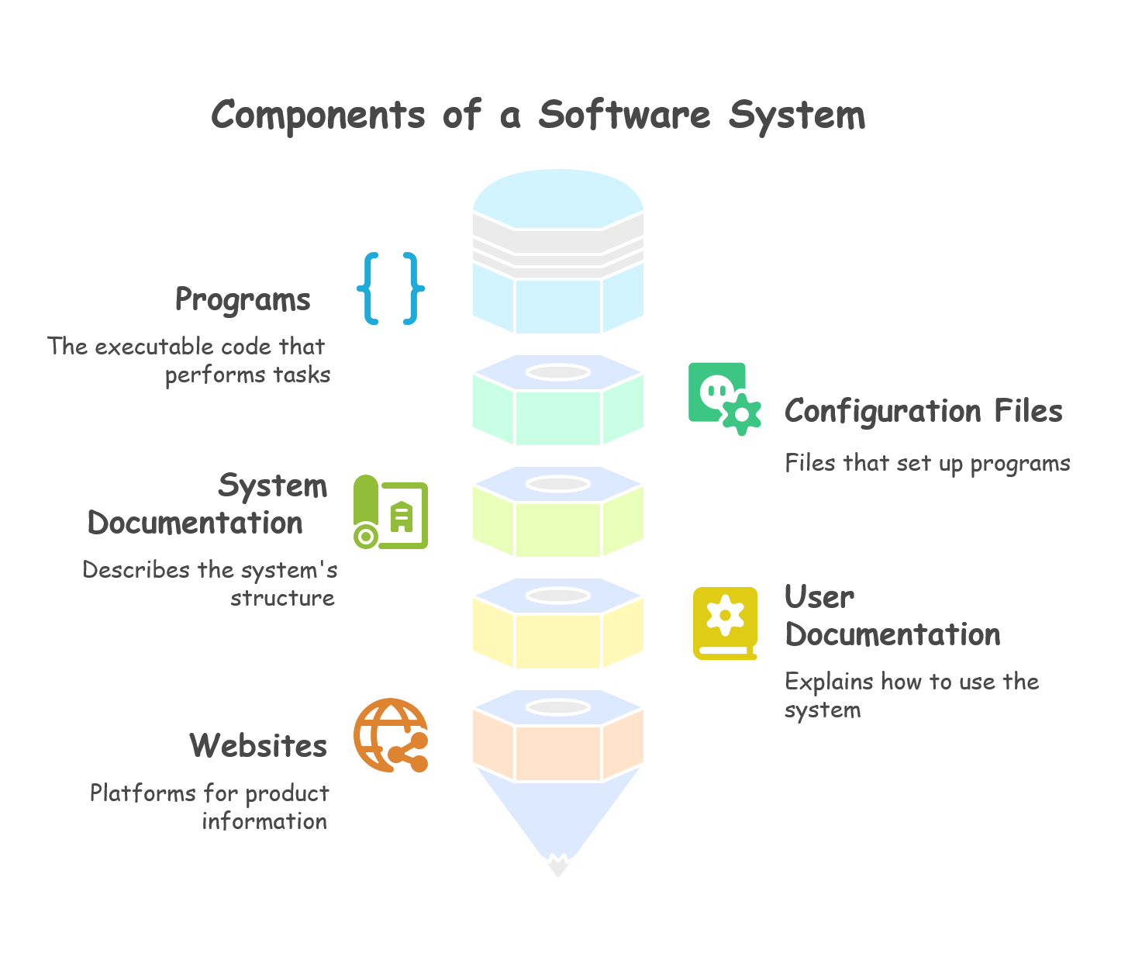
What is software
Software is a set of instructions, data, or programs used to operate computers and perform specific tasks. It is intangible, meaning it exists digitally and cannot be touched like hardware.

Slide 6
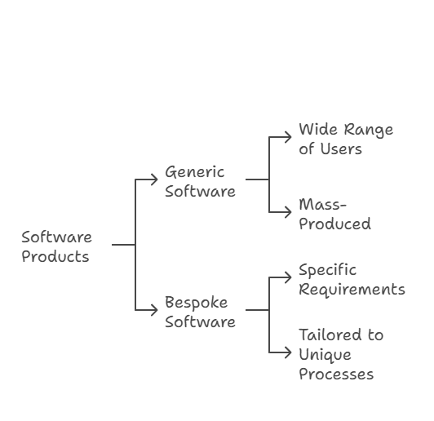
Software product categorization

Slide 7
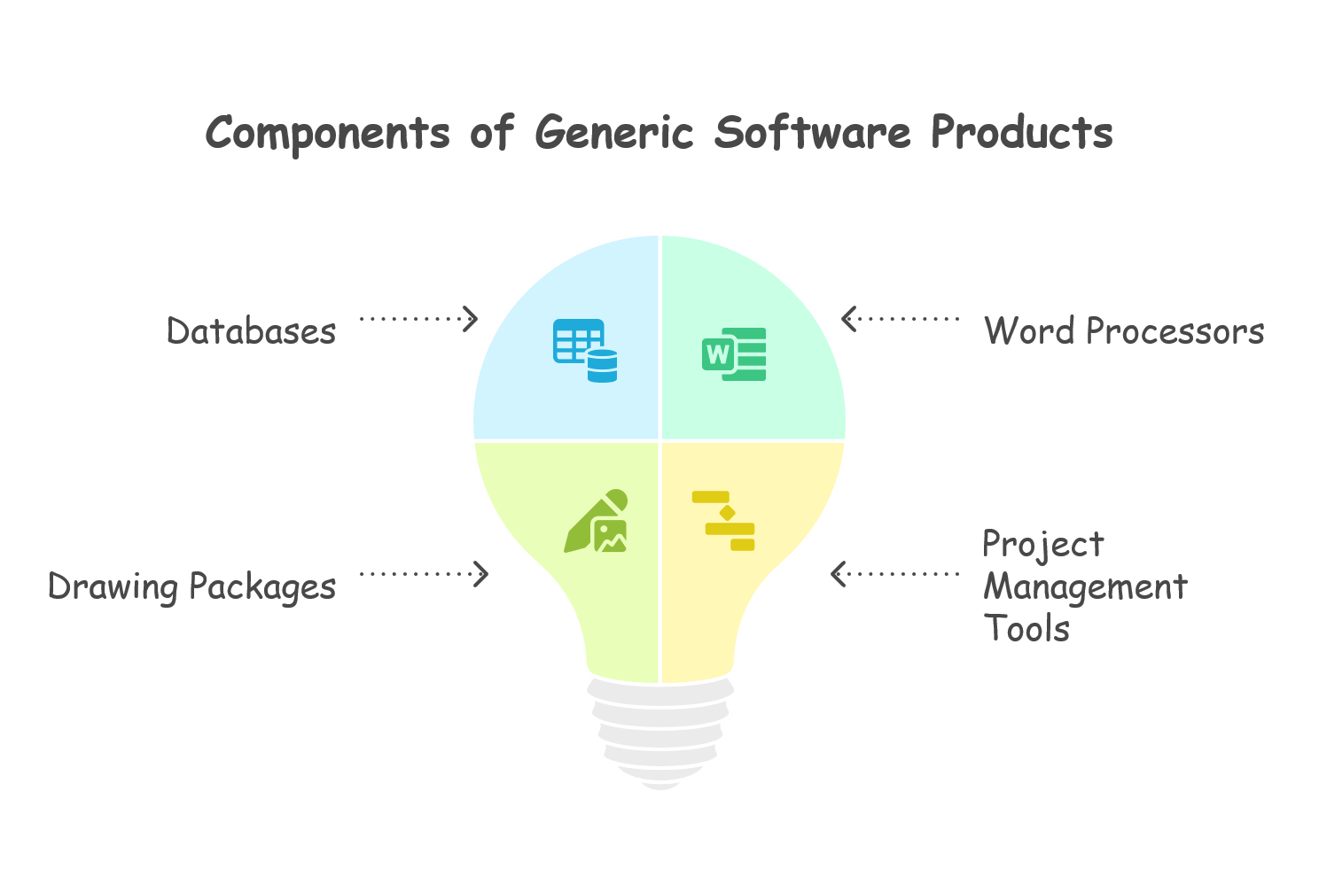
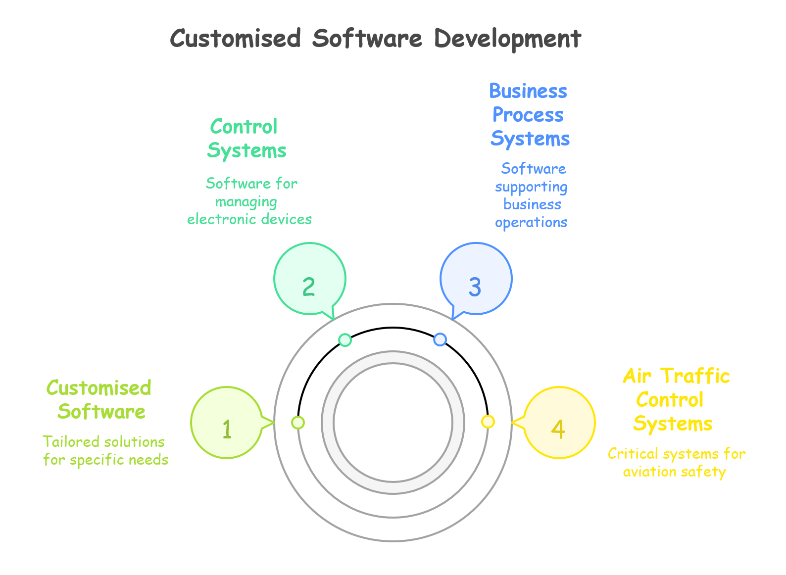

Slide 8
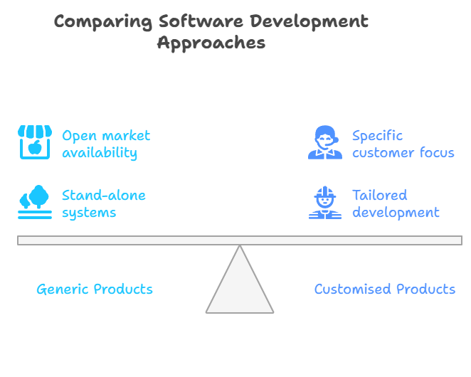

Slide 9
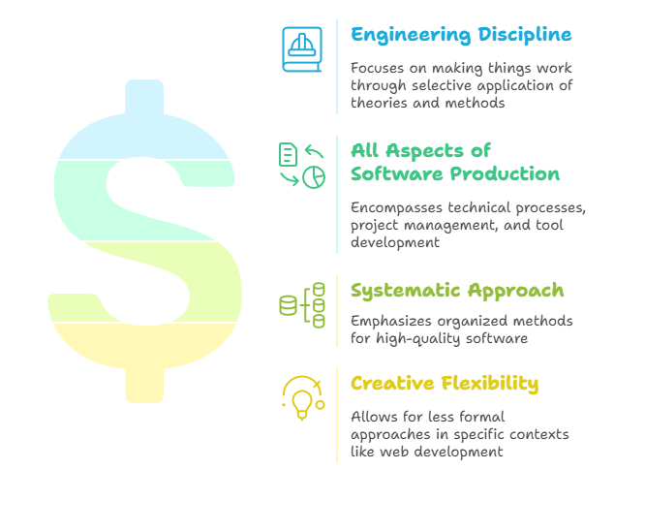
What is Software Engineering?
Software engineering is an engineering discipline that is concerned with all aspects of software production from the ready stages of system specification to maintaining the system after it has gone into use.

Slide 10
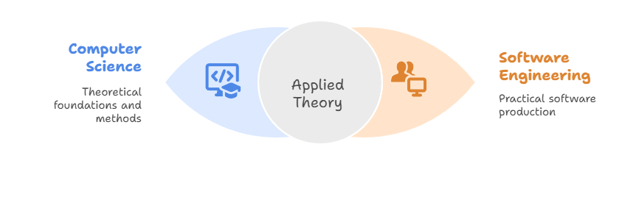
Software Engineering V/S Computer Science

Slide 11
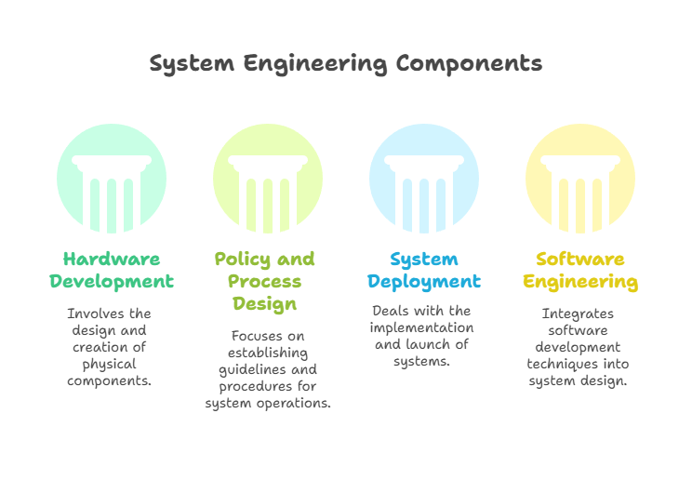
Software Engineering V/S System Engineering
System Engineering is the discipline focused on designing and integrating the entire system, including hardware, software, environment, and human interaction to meet user requirements.

Slide 12
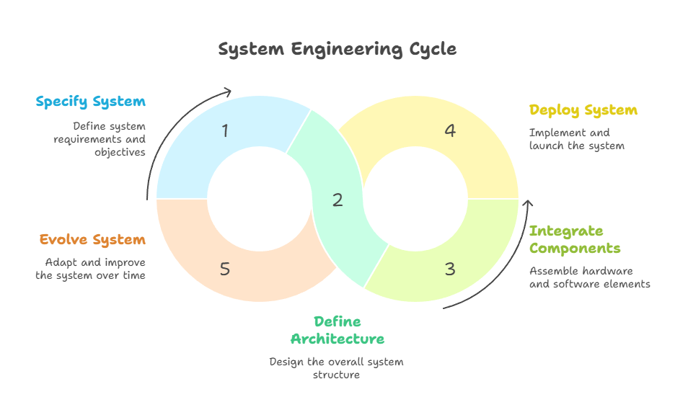

Slide 13
Software Process
A software process is the set of activities and associated results that produce a software product.
There are four fundamental process activities.
Software specification where customers and engineers define the software to be produced and the constraints on its operation.
Software development where the software is designed and programmed.
Software validation where the software is checked to ensure that it is what the customer requires.
Software evolution where the software is modified to adapt it to changing customer and market requirements.

Slide 14
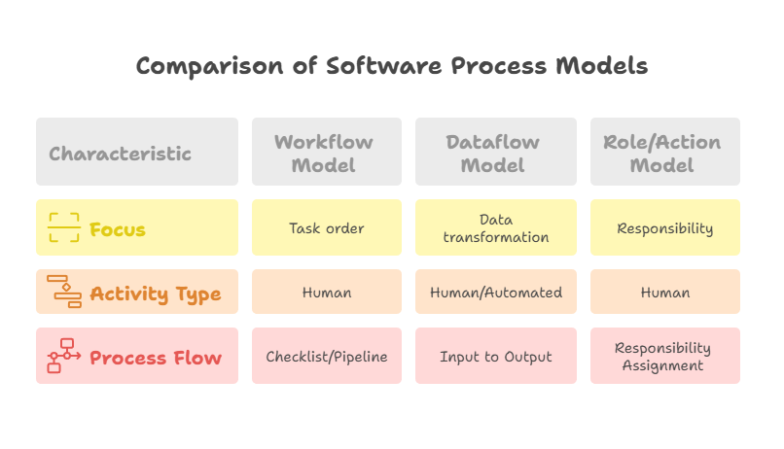
Software Process Model
A software process model is a simplified description of a software process that presents one view of that process. Process models may include activities that are part of the software process, software products and the roles of people involved in software engineering.
Types of software process model:
Work flow model
Activity or data flow model
Action or role model

Slide 15

Let’s prepare Pizza
How can I prepare a pizza?
What ingredients do I need?
What type of pizza should I make – veg/non-veg, size, crust?

Slide 16
Requirement gathering and analysis
How can I prepare a pizza?
What ingredients do I need?
What type of pizza should I make – veg/non-veg, size, crust?

Slide 17
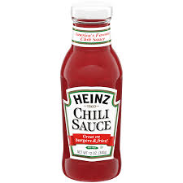
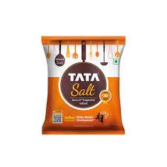


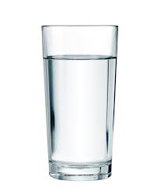

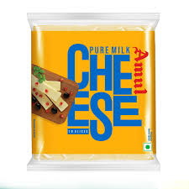
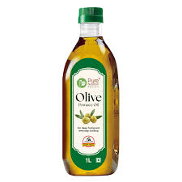
Requirement gathering and analysis
How can I prepare a pizza?
Using oven or furnace
2. What ingredients do I need?
3. What type of pizza should I make
non-veg, 10cm radius , crust, extra cheese

Slide 18
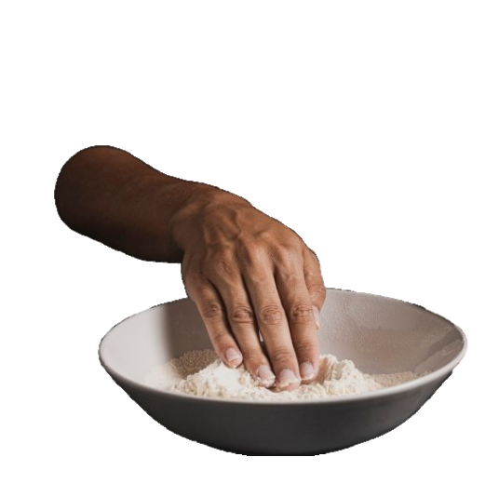

Designing
Let’s prepare the dough and set the oven

Slide 19
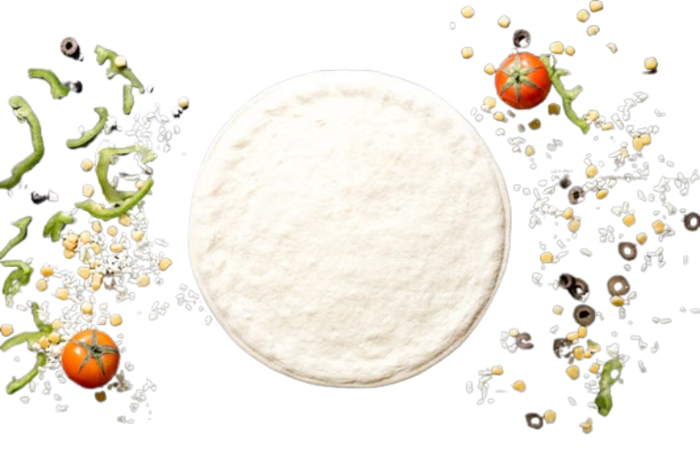
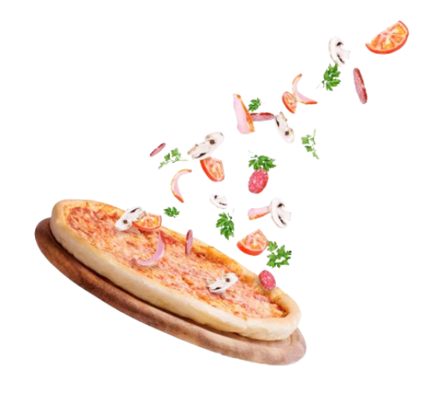
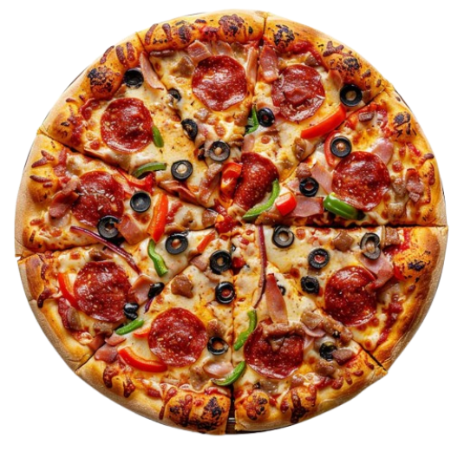
Coding and implementation
Let’s assemble the ingredients on pizza dough

Slide 20


Testing and feedback
Nice,
delicious
Chewy,
Dough is not baked properly

Slide 21
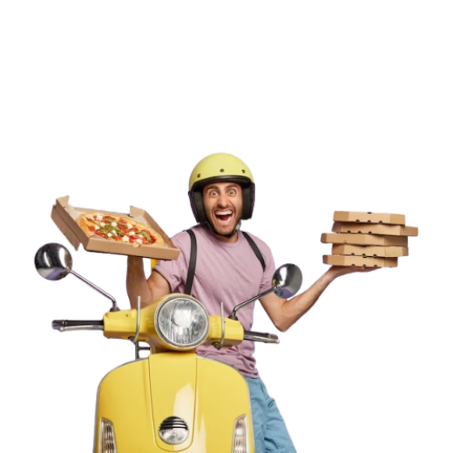

Deployment and maintenance

Slide 22
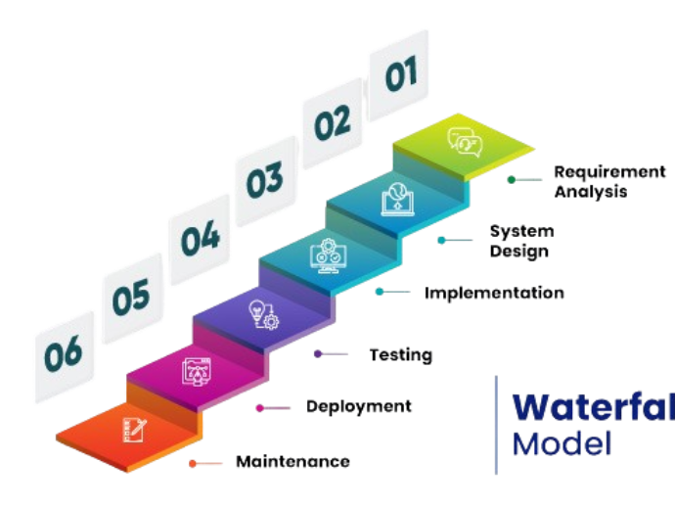
The waterfall approach
This takes the above activities and represents them as separate process phases such as requirements specification, software design, implementation, testing and so on. After each stage is defined it is 'signed-off, and development goes on to the following stage.
Advantages
Simple to understand and use.
Clear structure and well-defined phases.
Easy to manage due to strict documentation.
Best suited for well-defined requirements.
Limitations
Inflexible to change once the process starts.
Poor model for complex and long-term projects.
Late discovery of issues (testing only comes after coding).
Customer does not see the working product until the end.

Slide 23
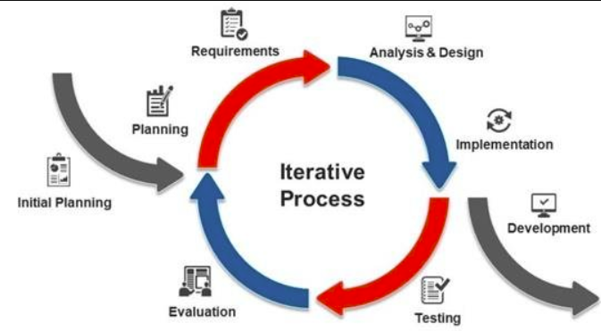
The Iterative development
This approach interleaves the activities of specification, development and validation. An initial system is rapidly developed from very abstract specifications. This is then refined with customer input to produce a system that satisfies the customers needs. The system may then be delivered. Alternatively, it may be reimplemented using a more structured approach to produce a more robust and maintainable system.
Advantages
Early working software is available.
Incorporates customer feedback quickly.
Easier to detect and fix bugs early.
More flexible to changes in requirements.
Limitations
Requires more involvement from the client.
May lead to scope creep due to repeated iterations.
Initial architecture might suffer due to rapid prototyping.
Harder to manage without strong planning.

Slide 24
Component-based software engineering (CBSE)
This technique assumes that parts of the system already exist. The system development process focuses on integrating these parts rather than developing them from scratch
Advantages
Reduces development time and cost.
Increases reliability (reused components are well-tested).
Encourages modularity and reusability.
Promotes consistency in the system.
Limitations
Integrating components may be complex (compatibility issues).
Hard to find exactly matching components.
Customization may be limited.
Dependence on third-party components for critical features.

Slide 25
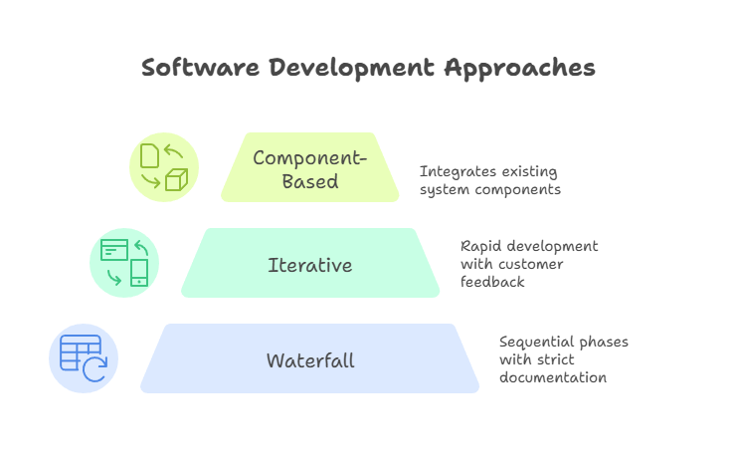

Slide 26
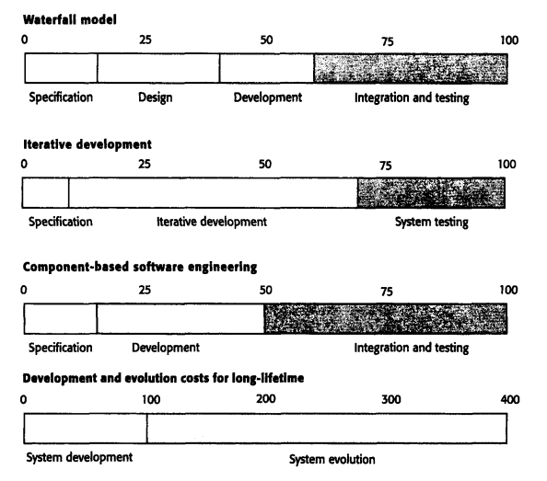
What are the costs of software engineering?

Slide 27
What are software engineering methods?
A software engineering method is a structured approach to software development whose aim is to facilitate the production of high-quality software in a cost-effective way. Methods such as Structured Analysis and JSD(Jackson Structured Design) were first developed in the 1970s. These methods attempted to identify the basic functional components of a system function-oriented methods are still used. In short it offers the methods to carry out the each phase of software development
Component | Description | Example
System Model Descriptions | Describe the types of models used to represent the system and the notation or syntax used. | Object models (UML class diagrams), data-flow models (DFD), state machine models, sequence diagrams
Rules | Define constraints or properties that must always hold true across models. | "Every entity must have a unique name"; "No two classes can have the same identifier"
Recommendations | Give heuristics or best practices that help ensure quality and clarity in design. | "No object should have more than seven sub-objects" → helps reduce complexity (Cohesion principle)
Process Guidance | Provides steps or activities to develop models and the order in which they should be performed. | "Define object attributes before operations"; "Identify use cases before designing classes"

Slide 28
What is CASE?
CASE (Computer-Aided Software Engineering) refers to software tools that support the activities of software development and maintenance. These tools help automate, assist, and standardize various phases of the software engineering process from planning and design to coding, testing, and documentation.

Slide 29
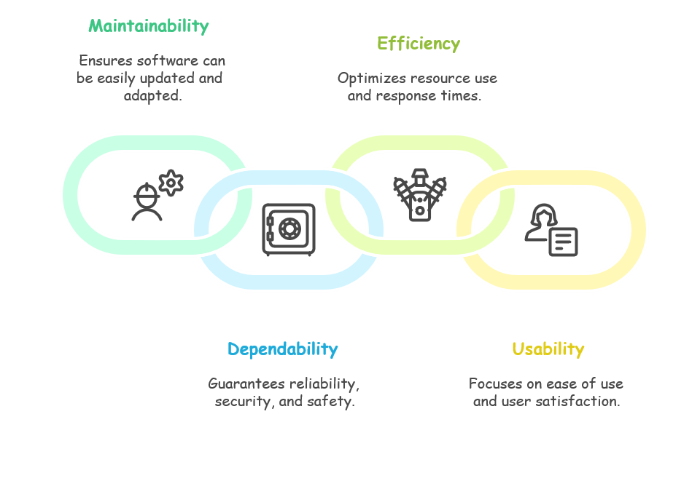
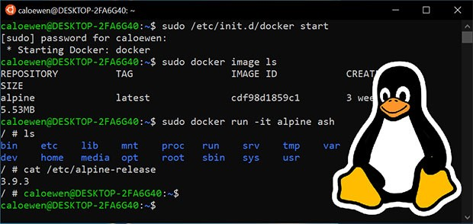
What are the attributes of good software?

Slide 30
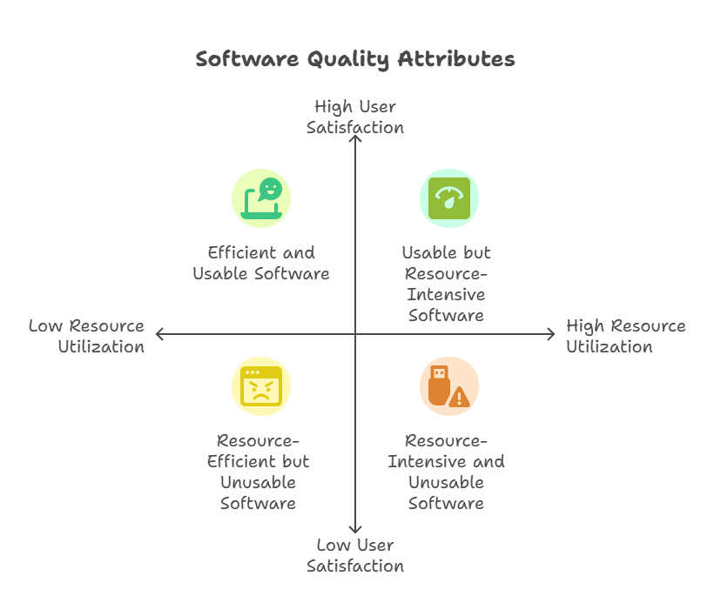

Slide 31
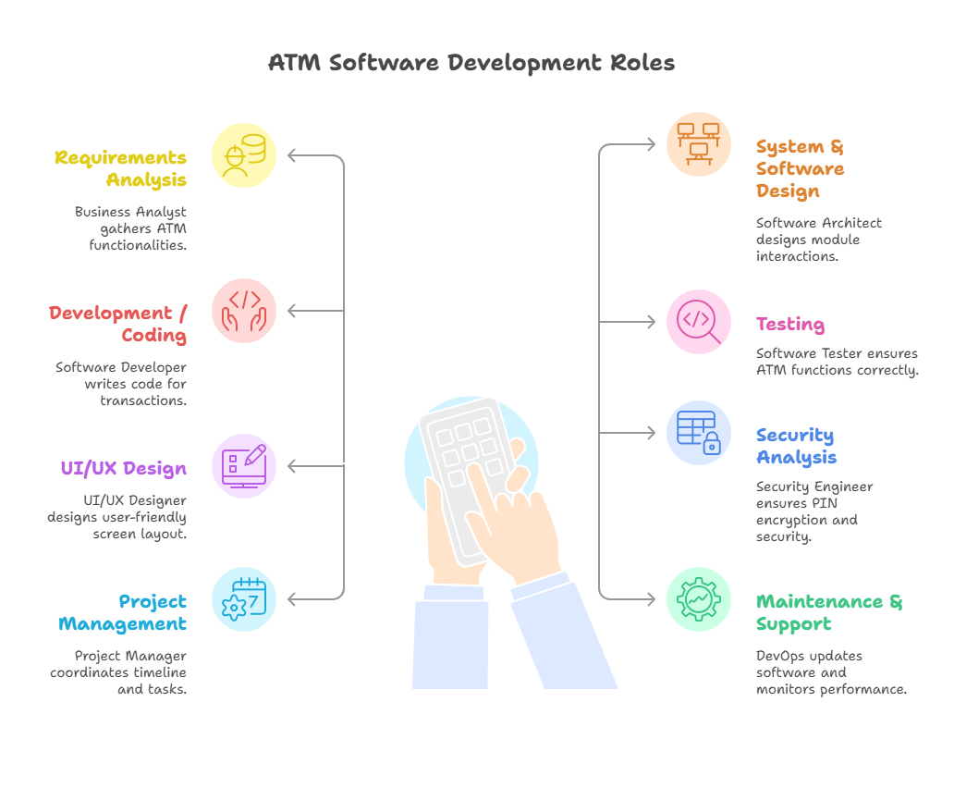

Slide 32
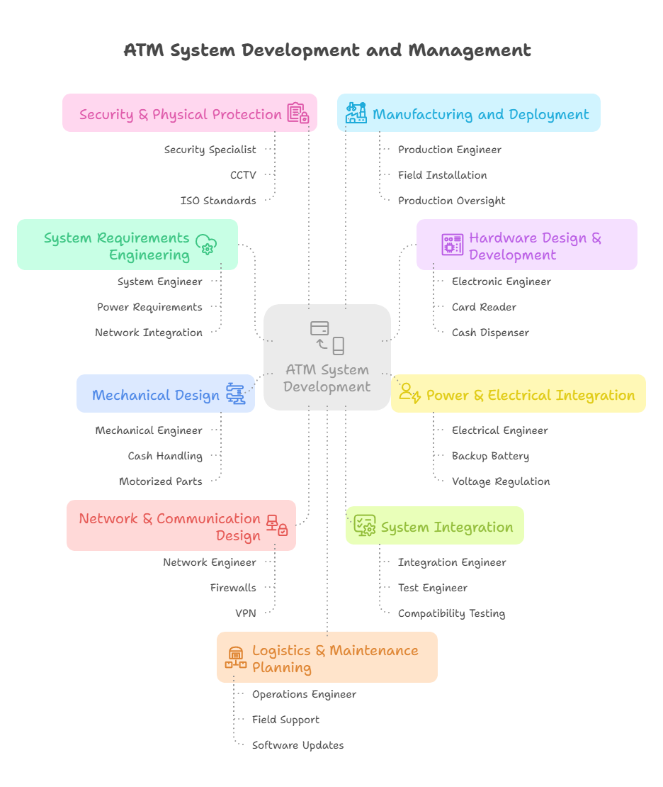

Slide 33
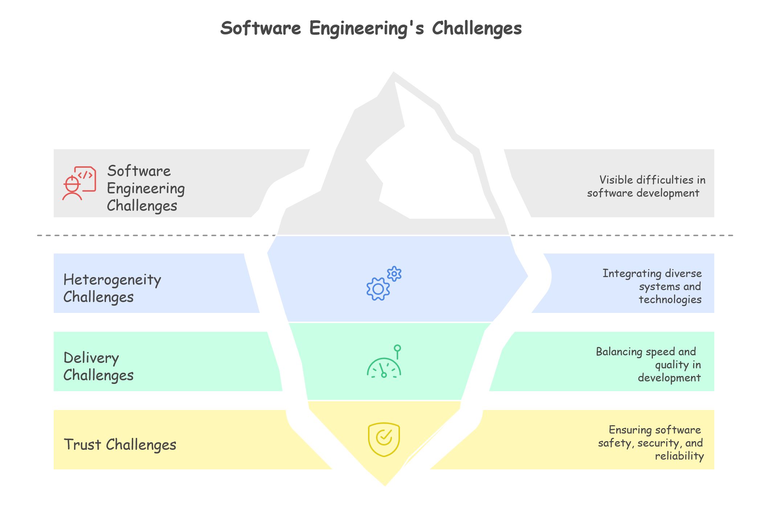

Slide 34
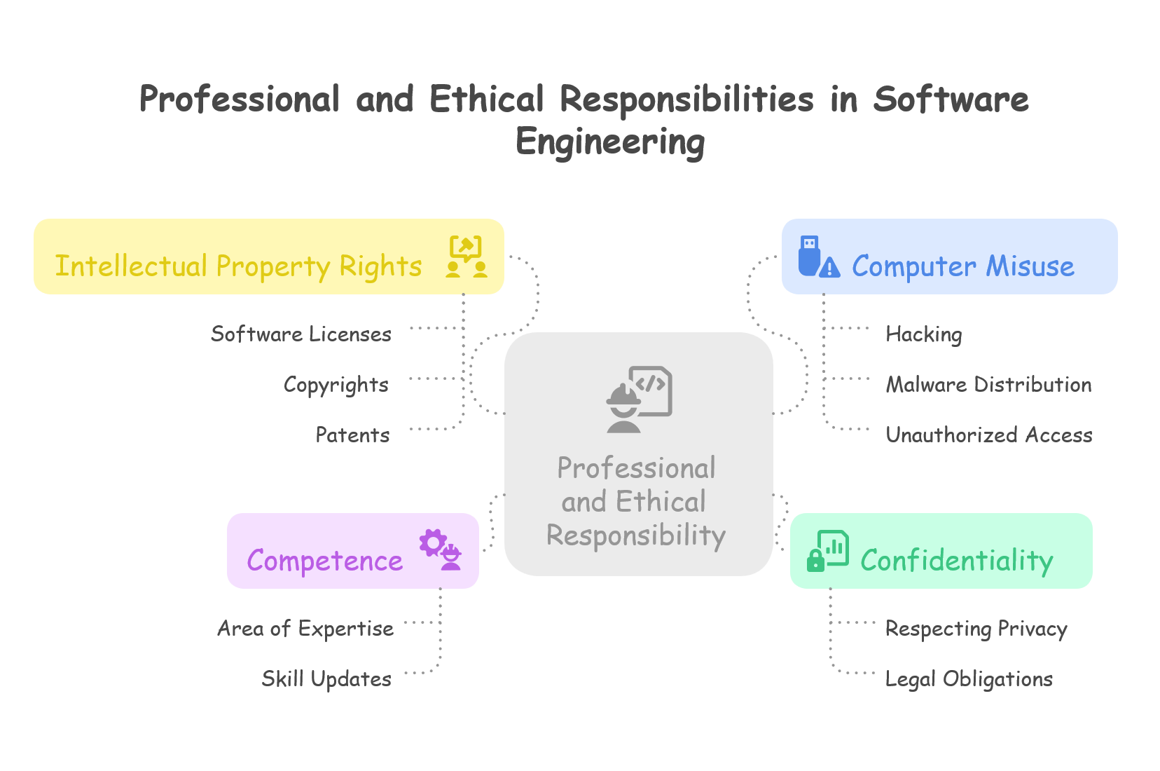

Slide 35
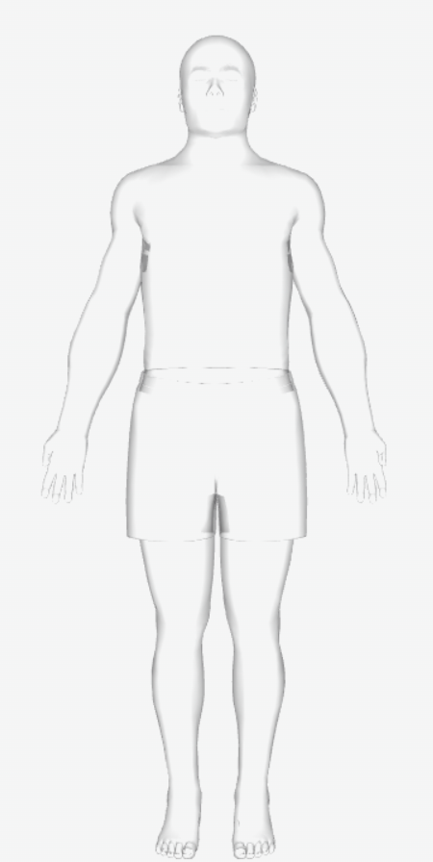
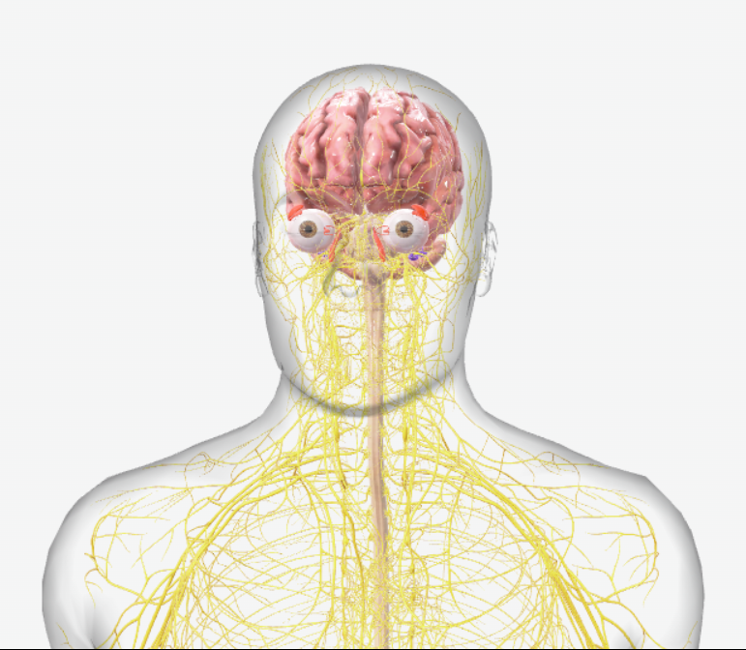
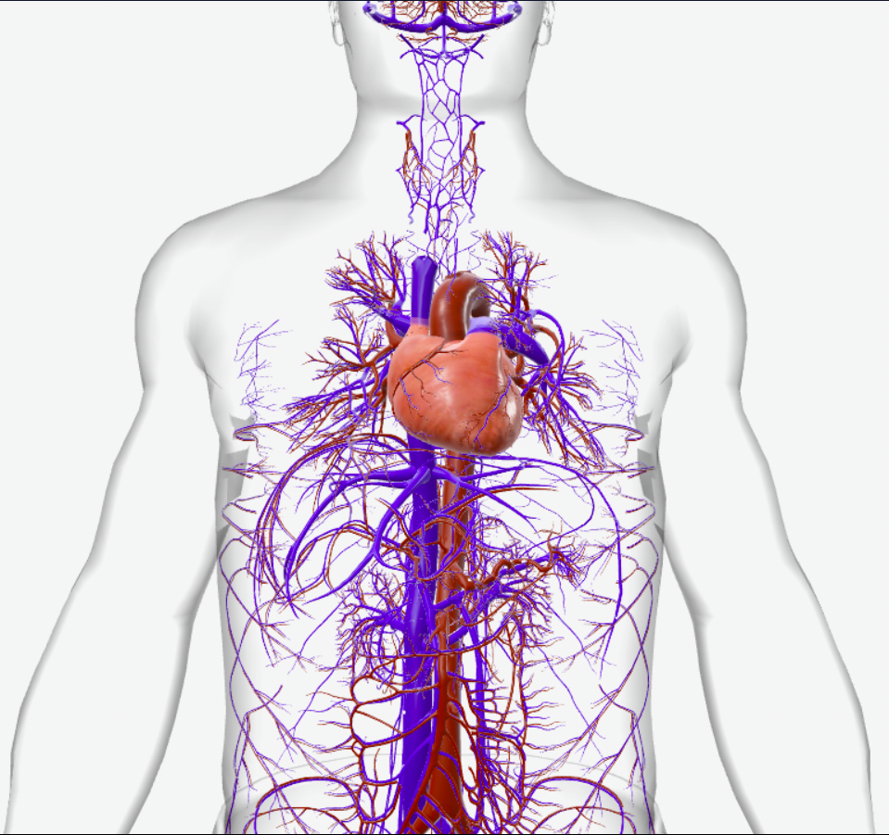
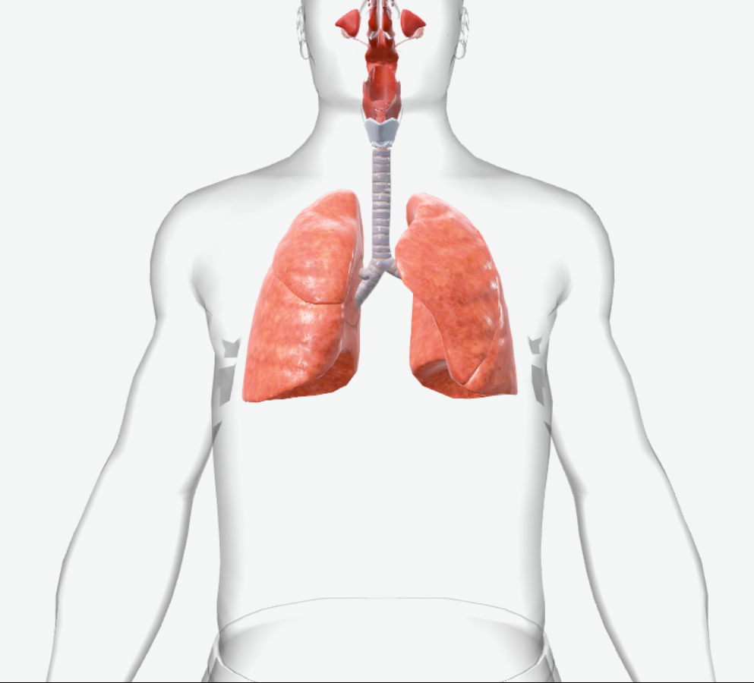
Software engineering of Human Anatomy
35

Slide 36


Software Architecture & Decision Logic
Just as the brain controls the functions of the body, the software architecture defines how components interact and how logic flows. MVC (Model-View-Controller) is like the brain assigning roles vision (view), action (controller), and memory (model).
36

Slide 37



Core Algorithms and Business Logic
The heart powers the body with blood; algorithms and logic power applications by processing data and producing outcomes.
A billing software's tax calculation function is the heart of its logic.
37

Slide 38



APIs and Data Interfaces
Lungs exchange gases between the body and environment; APIs exchange data between systems or layers. REST APIs act like lungs by "breathing" data in (GET) and out (POST).
38

Slide 39
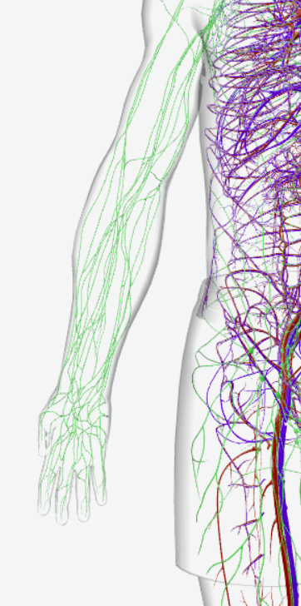


Data Flow and Communication
Blood carries oxygen and nutrients; data flow carries information across the system — between modules, processes, or networked devices.
Kafka streams or gRPC channels are like arteries of a microservices system.
39

Slide 40
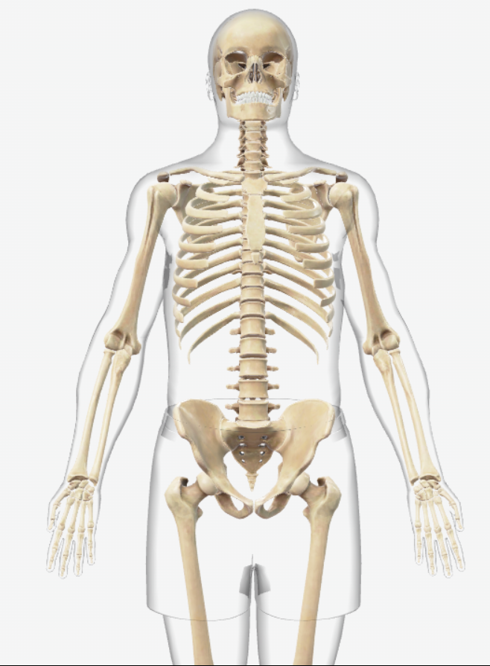



Software Frameworks
The skeleton provides structure and support, just like frameworks (like Django, Spring) provide structure to applications. A Python web app built on Flask has Flask as its skeleton.
40

Slide 41
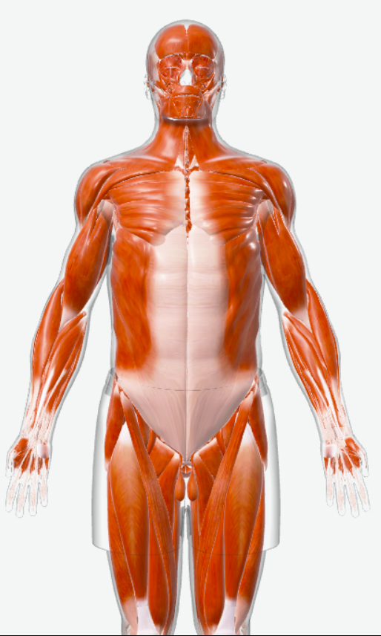





Functional Modules
Muscles perform actions. In software, modules (e.g., login, payment) perform specific tasks.
A 'Search' module in an app is like a muscle for fetching information.
41

Slide 42




User Interface (UI/UX)
Skin is what others see and interact with; UI/UX is how users interact with software. Material Design in Android apps is like polished skin.
42

Slide 43
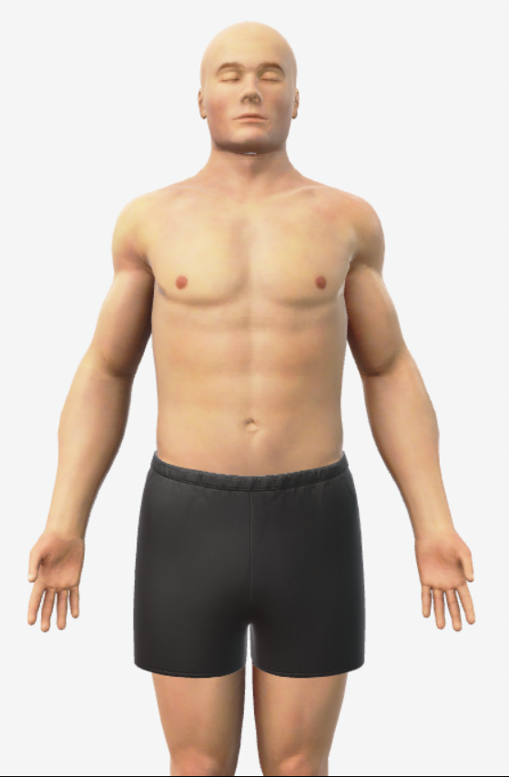
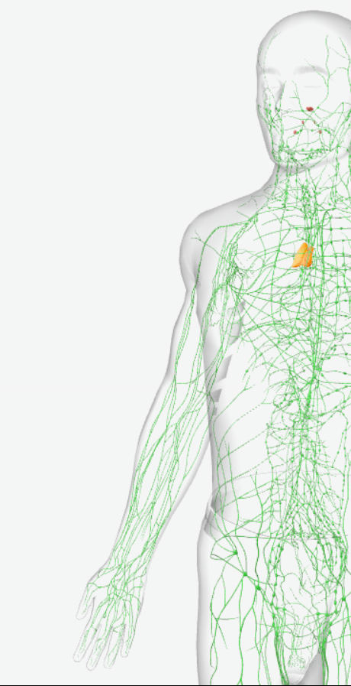



Security & Testing
The immune system protects against threats; security protocols and testing (unit, integration, fuzz) protect software from bugs and breaches.Penetration testing acts like antibodies recognizing vulnerabilities.
43

Slide 44
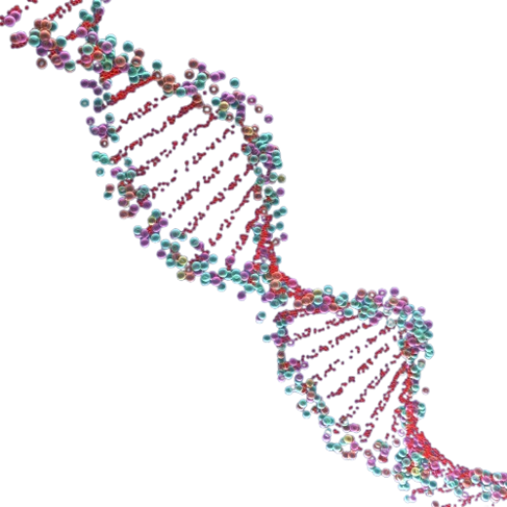


Codebase / Source Code
DNA contains instructions for building and maintaining the body; source code contains instructions for running the software. GitHub repositories are like a genome library.
44

Slide 45
